Slide 1
Cover slide
Style 4
(choose one, delete the rest)
Climate Change: Implications for the NHSScotland Estate
Presentation to Capital Investment Network:
02 May 2017
Kathryn Dapré
Head of Engineering, Energy & Sustainability
NSS Health Facilities Scotland
Notes:
Thank you for the invitation to present to your group.

Slide 2
Quote Page
Style
Climate Change and Healthcare
Climate change is the biggest global health threat of the 21st century.”
UCL-Lancet Commission on Managing the Health Effects of Climate Change, 2009
Notes:
In 2009, the Lancet called climate change the biggest global health threat of the 21st century. Keep this quote in mind as I’ll be returning to it later.

Slide 3
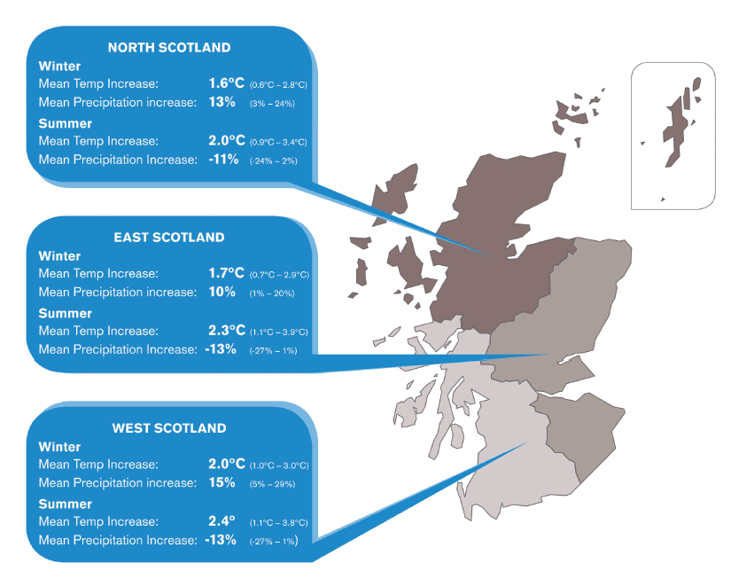
Climate Change in Scotland
Adverse health impacts
Building damage
Crop damage
Increased costs (insurance, fuel poverty)
Hotter, drier summers (risk of heatwave./ drought)
Milder, wetter winters (risk of flooding)
More extreme weather events
Longer growing seasons
Increased tourism
Notes:
Within Scotland and rUK, in comparison to other parts of the World, the effects will be ‘relatively’ minor. We will still see hotter, drier summers, more precipitation and more extreme weather events, but not to the extent or impact of other areas. Negative impacts – will talk more about adverse health. But positive too – I never thought I’d see the day where we had an outdoor cafe culture in Glasgow.

Slide 4
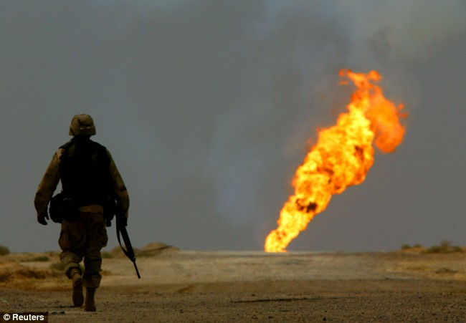
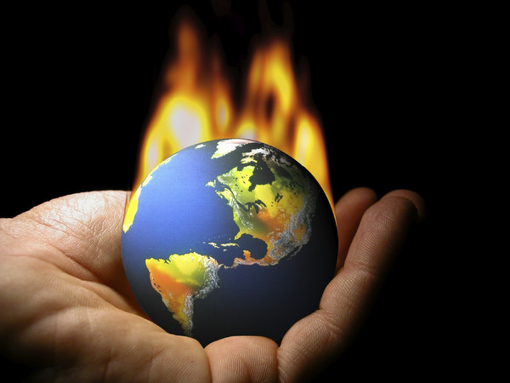
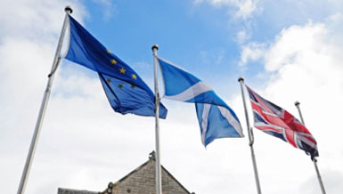
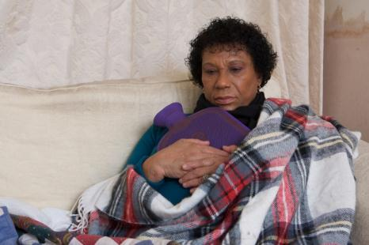
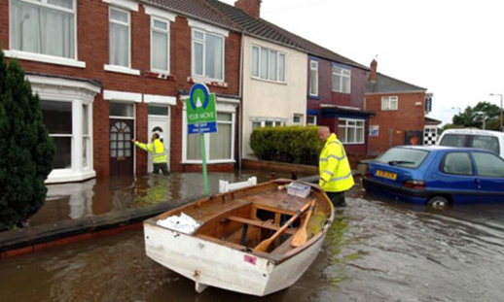
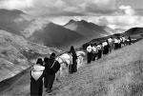
It’s Not Just About Carbon....
Notes:
I’m not here to convince you on the climate change science. At this stage, you either believe it or you don’t. But let me give you some other reasons for prioritising this:
Energy prices – highlight rise, proportion of bills, etc
Energy security
CSR
Health impacts
Direct health impacts – heat related illness (French heatwave 2003), flooding, respiratory, injuries, fuel poverty – winter mortality, vector bourne disease (species migration), psychological effects, shift in bed admissions.
Indirect – crop scarcity, civil unrest, climate change migration....
And if you’re still not convinced, it doesn’t matter. There is legislation that says you have to take it seriously.

Slide 5
Slide style containing only text
NHSScotland’s Impact
Direct Impacts (not including public health)
c. 160,000 employees (c. 6% of Scotland’s workforce)
> 4.6 million m² estate
Energy consumption around 1.8 TWh p.a.
Direct greenhouse gas emissions around 650,000 tCO₂e p.a. (c. 1.4% of Scotland’s total greenhouse gas emissions)
Annual energy bill c £100M (+CRC, + EU ETS)
Annual waste arisings around 50,000 tonnes p.a.
Indirect Impacts
Supply chain emissions
Staff, patient and visitor travel
Biodiversity and greenspace
Corporate Social Responsibility
N.B.
Body Copy always uses Dark Blue NHS colour.
Notes:
As an entity, NHSScotland has a huge impact on Scotland’s sustainability. We’ve already heard from Phil Mackie how NHSScotland has a direct impact on sustainable health. I’d like to give you some more statistics relating to other impacts.
We employ over 154,000 staff - not including temporary staff or contractors. This represents 6% of Scotland’s workforce. That’s over 154,000 people using our facilities, consuming our resources, travelling to our sites, etc.
Our estate covers over 4.6million square metres – that’s over 1,200 buildings ranging from the new Queen Elizabeth University Hospital in Glasgow, to the smallest clinics in Shetland, to offices, labs, laundries, retail space.... and even this very hotel. An extremely challenging and diverse estate to manage both safely and sustainably.
That estate consumes around 1.8 Tera-watt-hours of energy each year, resulting in greenhouse gas emissions in excess of 650,000 tonnes per year. That’s equivalent to around 1.4% of Scotland’s total emissions.
The same estate leads to annual waste arisings of around 50,000 tonnes.
In addition to these direct impacts, there are other indirect impacts for which we are responsible. NHSScotland spends around £2.6billion each year on goods and services – goods and services which themselves have an environmental impact in their manufacture, raw material use, transport and disposal.
We support a growing Scottish population of over 5.3million residents. That’s over 1.5million patients treated in our hospitals and clinics each year – and all these patients, and their supporting carers and visitors, have to get to and from our premises.
Our estate comprises an extensive amount of greenspace – a large proportion of which is underutilised. We have a responsibility to manage and maintain that greenspace to support biodiversity and nature conservation, and to promote health benefits.
Finally, there is our Corporate Social Responsibility. Second only to Scottish local authorities, we are the public sector entity that has the most interaction with and impact on Scotland’s people. We should lead by example to ensure that Scotland continues to lead the world in sustainable development.

Slide 6
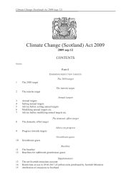
Legislation and Policy Drivers
?
Notes:
Climate Change Act 2009 – talk about targets. Other underpinning acts and legislation relating to climate change reporting, biodiversity reporting, etc.
Climate Change Plan (RPP3) – talk about plan and underpinning strategies
Will lead to revised Act and new legally binding targets. Other Acts

Slide 7
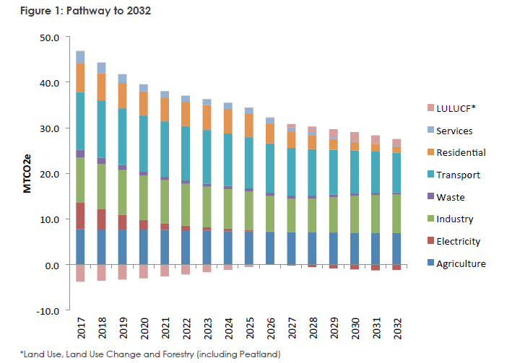
Slide style containing only text
Scotland’s Aspirations
New legally binding greenhouse gas reduction targets
N.B.
Body Copy always uses Dark Blue NHS colour.

Slide 8
Slide style containing only text
Scotland’s Aspirations
Eradication of fossil fuel for heating – including gas
Emphasis on low carbon district heating – 94% of non-domestic buildings within 15 years
Compulsory connection to local district heating
Zero waste to landfill and 50% reduction in food waste
ULEV transport fleets
Compulsory charges for all staff car-parking
N.B.
Body Copy always uses Dark Blue NHS colour.

Slide 9
Slide style containing only text
Potential Barriers Challenges
Lack of and access to capital funding
Available funding does not match project requirements
Rising electricity prices
Lack of innovation and ‘risk aversion’
Conflicting legislation (e.g. NHS Act vs district heating)
Collaborative working
Lack of preparation
Disconnect to clinical strategies
Design guidance unclear and ambiguous
Tortuous approval routes
N.B.
Body Copy always uses Dark Blue NHS colour.

Slide 10
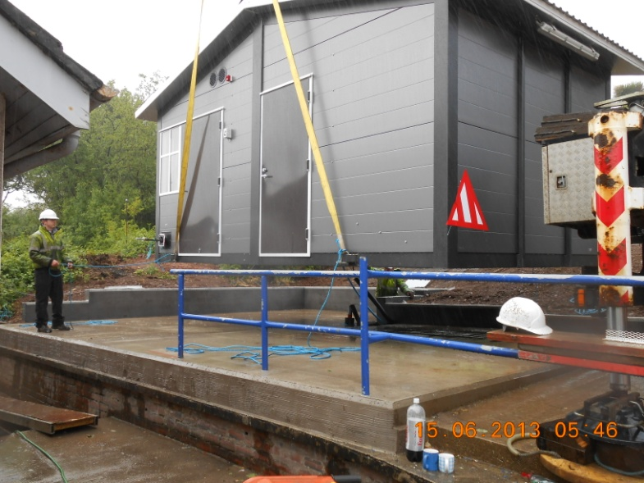
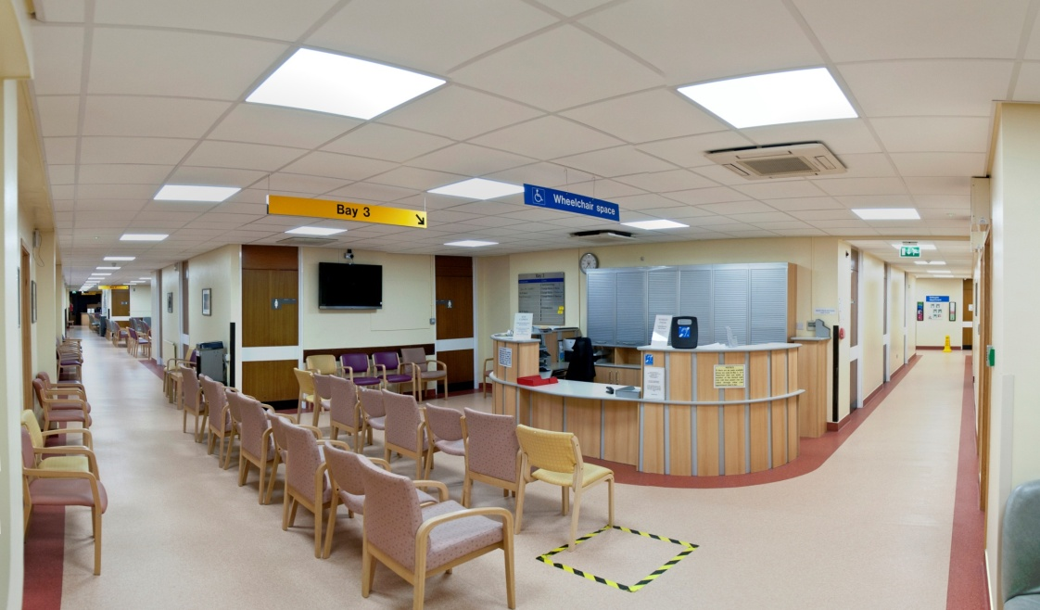
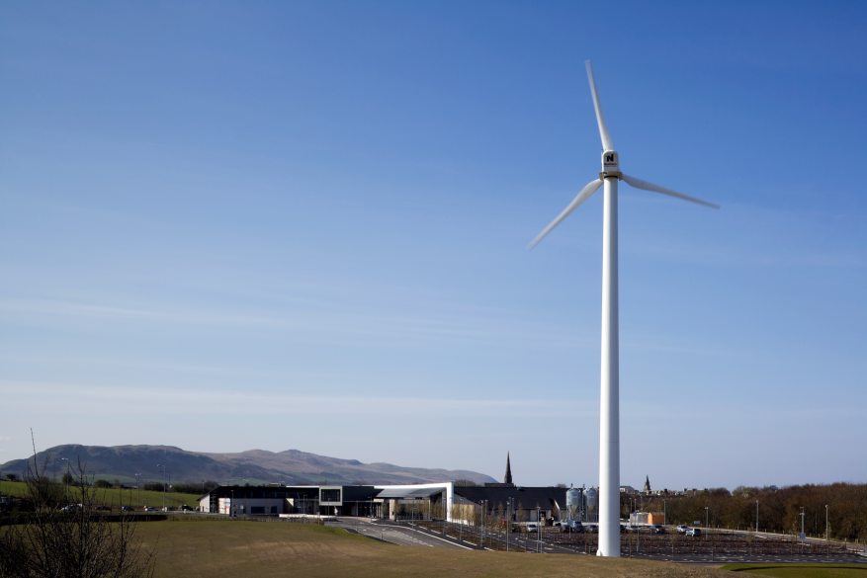
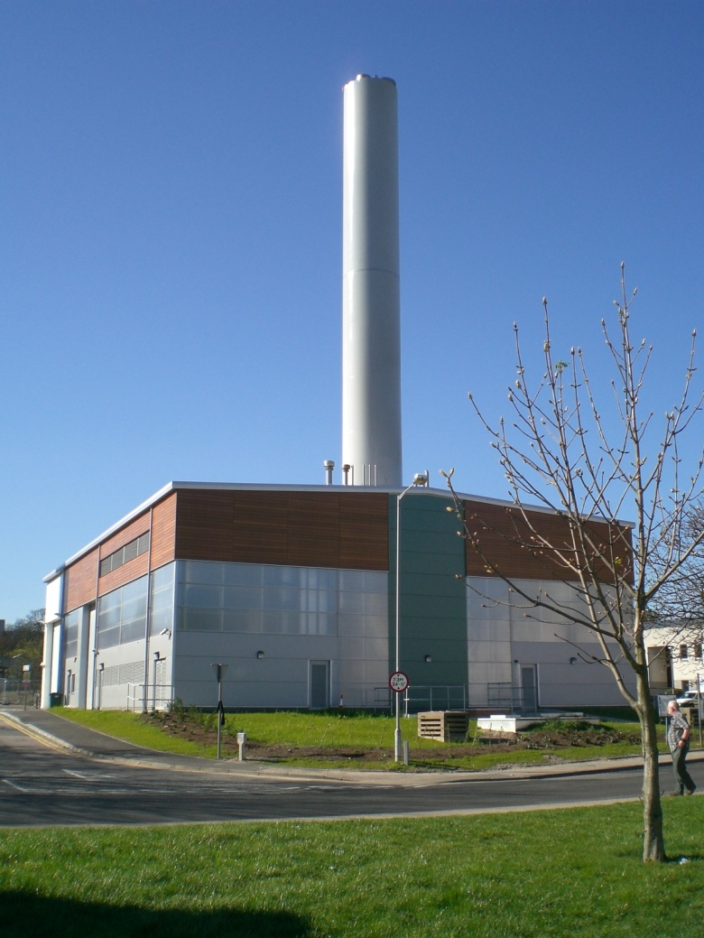
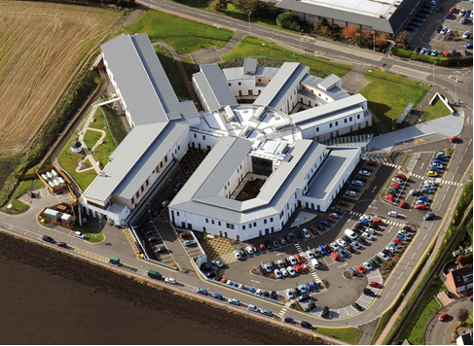
In the last 5 years, energy consumption down by >7% and GHG emissions down by >9%
Notes:
We’ve been doing pretty well. Our energy consumption is down, as is our CO2. We met our energy efficiency targets – missed our CO2 targets (but as I mentioned earlier, they were tougher, so we’re still following ‘Scotland’s’ trajectory).

Slide 11
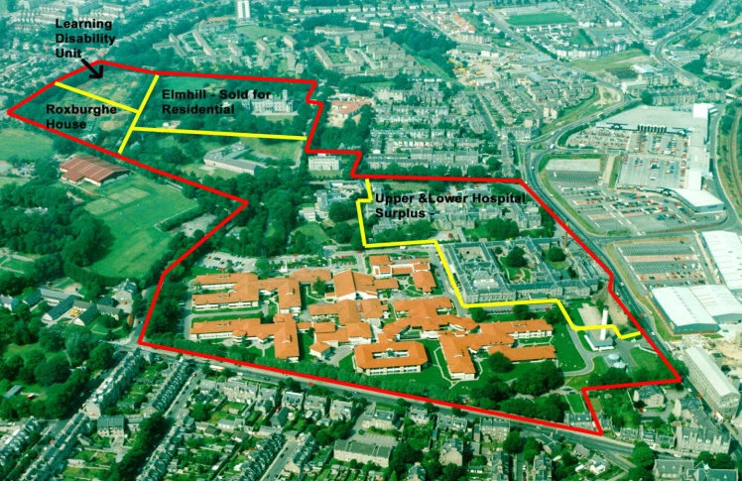
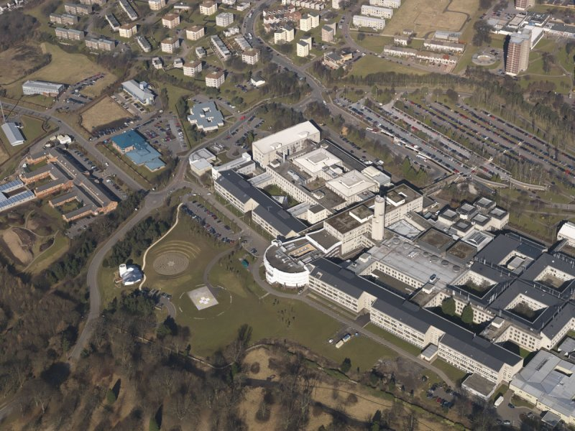
Energy Performance Contracting
Major energy infrastructure upgrades at 2 NHS Boards (covering 6 major sites)
Includes new energy centres (gas CHP), new biomass boilers, local district heating, LED lighting, downstream energy efficiency measures
Equivalent capital investment of c £44M (including life-cycling)
Guaranteed annual savings of c £4.6M, 17,500 tCO2
Further performance guarantees
Notes:
This was the first project to be taken through the CEF process, but ended up being the last to reach contract close.
It was a difficult project to do because of the huge learning curve for everyone involved.
<<Discuss the sites, main issues faced>>

Slide 12
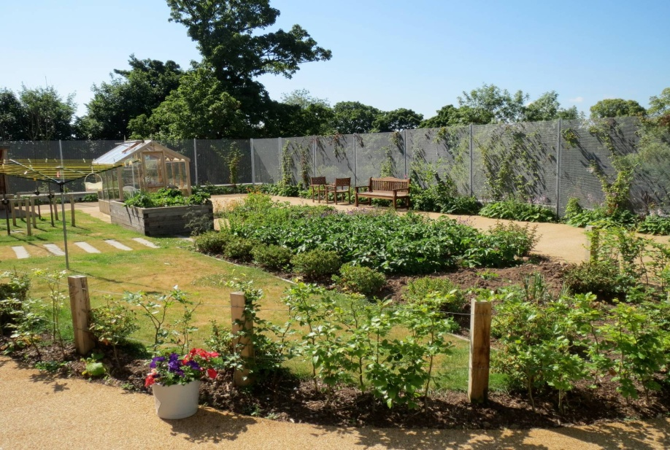
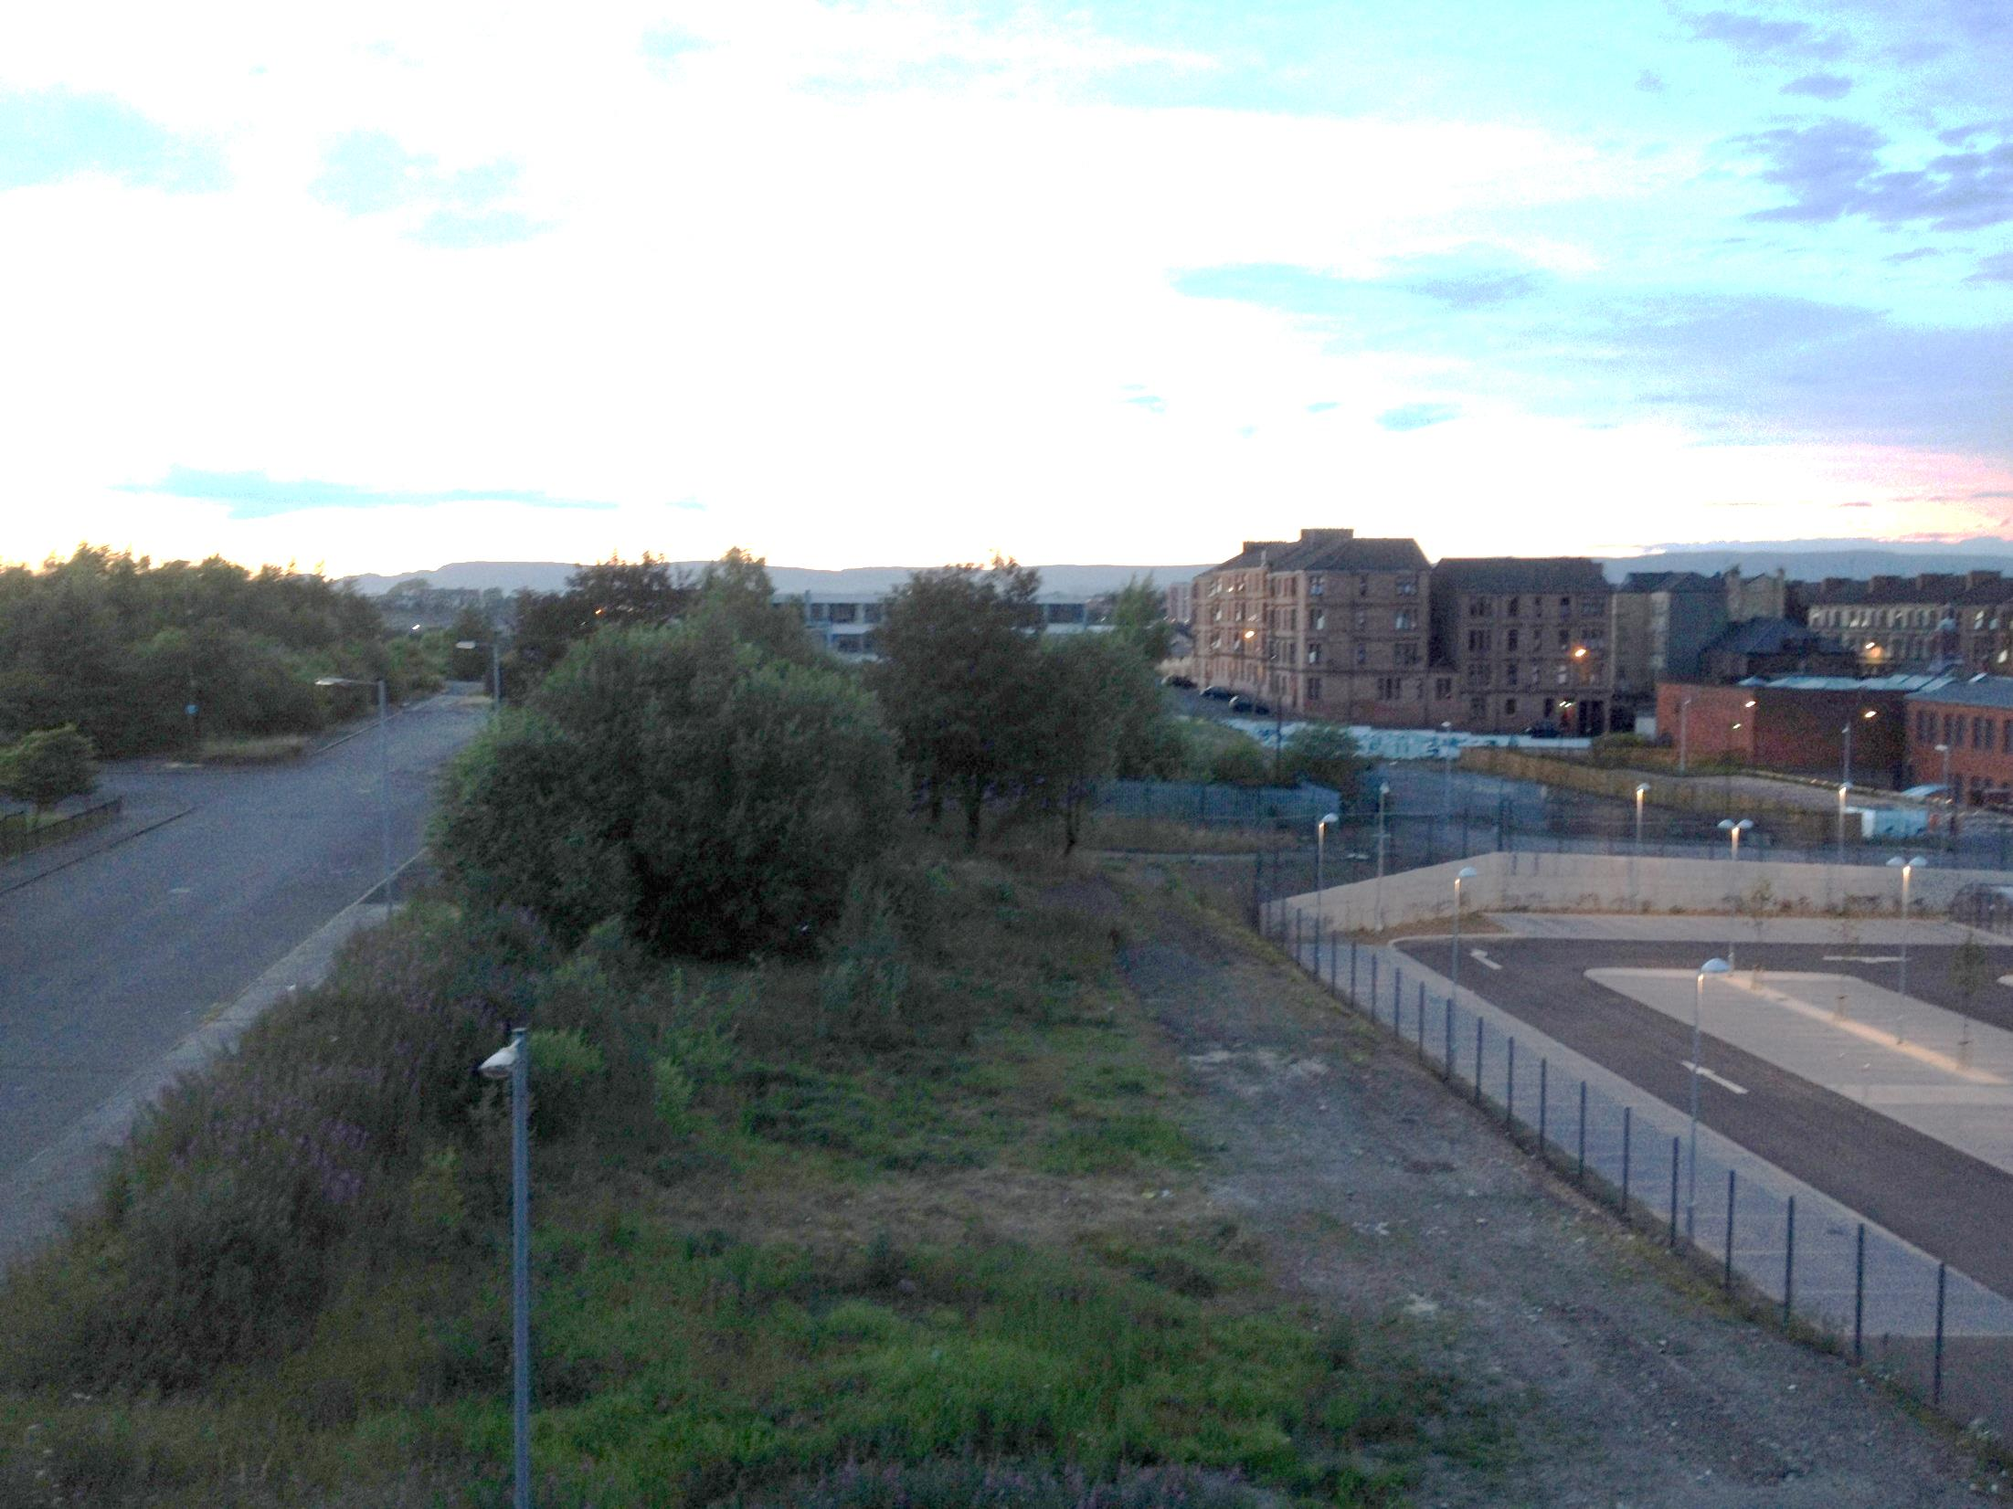
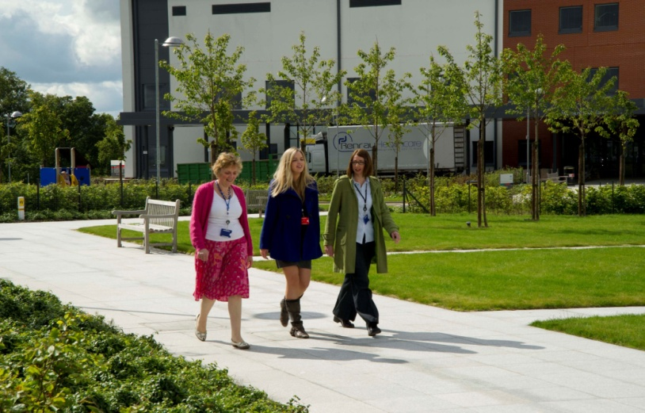
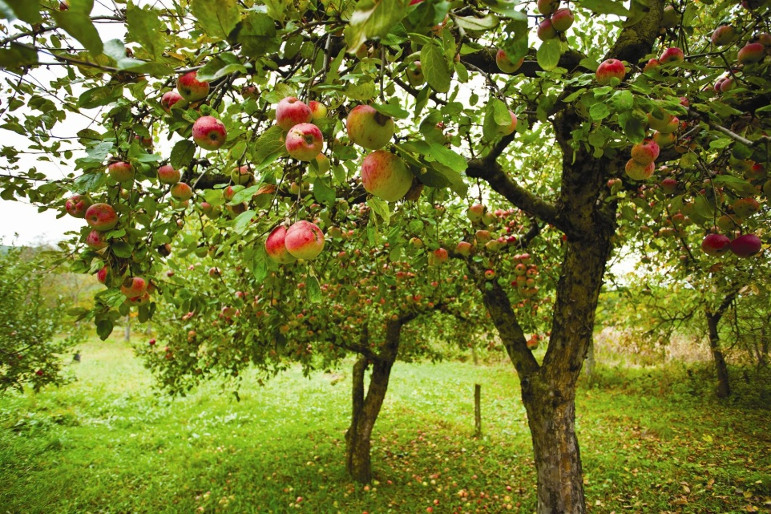
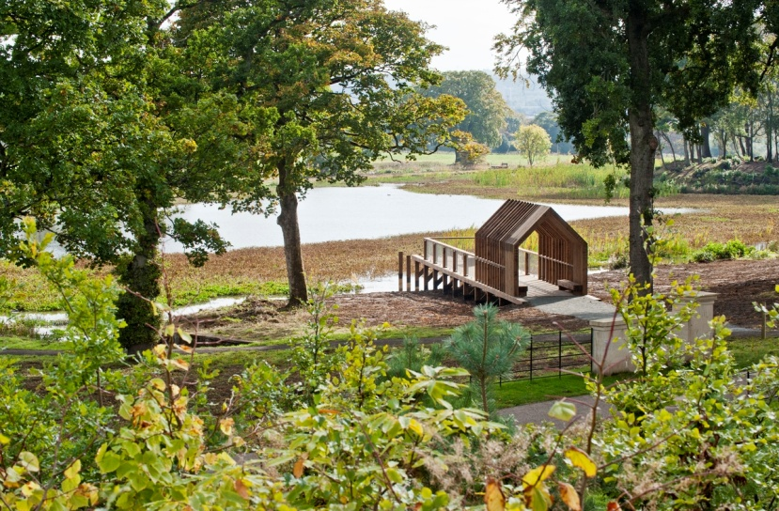
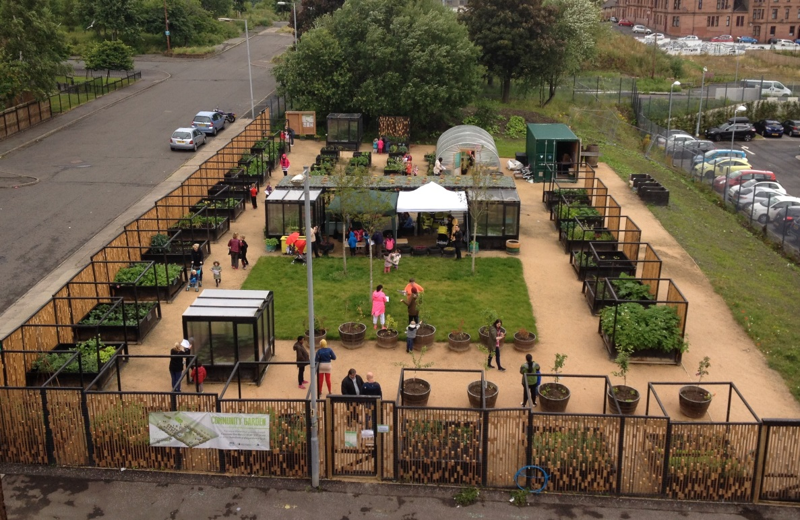
Images Only Slide
Greenspace Projects
Gartnavel Campus
Possilpark Health & Social Care Centre
Forth Valley Royal Infirmary
Shadow effect to be used: “Drop Shadow Rectangle”
N.B.
When scaling images/objects, please hold Shift key while scaling, to keep proportional shapes)
Notes:
Maybe hard to believe, but the pictures on the left were taken at a hospital campus within Glasgow City limits. This is the Gartnavel Hospital campus in the west end of the city. The project created new routes to increase access to parkland as well as providing new health-promoting accessible spaces, including growing areas for therapeutic and physical activity.
Perhaps more striking is the transformation of a derelict site within one of Glasgow’s most deprived areas. The new Possilpark Health & Social Care Centre saw the creation of a community growing space and landscaped garden. This is managed by a local community group and provides growing spaces for individuals, families and organisations, as well as a space for educational activities and course.
On the right is Forth Valley Royal Infirmary where a network of paths and trails was developed, both for local access and for therapeutic activities.

Slide 13
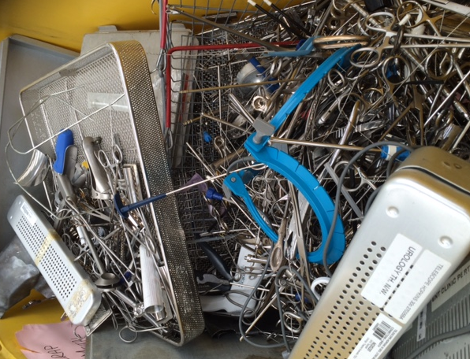
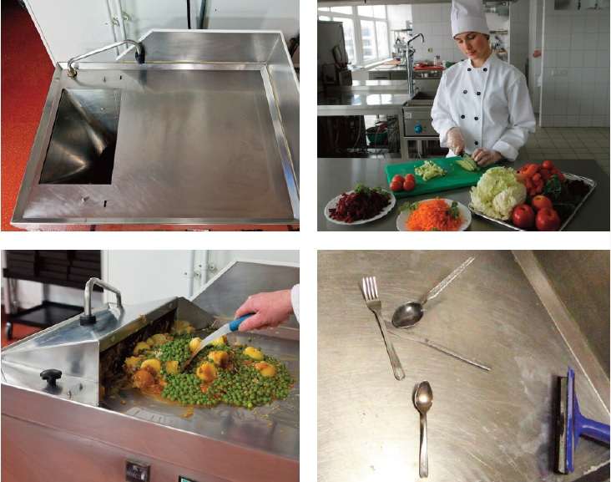
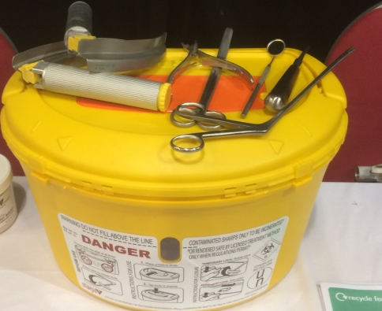
Images Only Slide
Waste & Resource Efficiency Projects
Circular Economy – Metal recovery
Food Waste Reduction
Shadow effect to be used: “Drop Shadow Rectangle”
N.B.
When scaling images/objects, please hold Shift key while scaling, to keep proportional shapes)
Notes:
On the left is an example of a circular economy project: metal recovery from medical instruments. Specialist re-usable boxes suitable for medical waste, including sharps, are being introduced at a number of NHS Boards. The boxes are supplied and taken back, emptied and cleaned as part of a service agreement. NHS Boards using the boxes for metal recovery are gaining value as rebates, typically 35-40%, are given. Pilots in podiatry over 18 months resulted in nearly 60 tonnes of metal being recovered and avoided the purchase and disposal of 9 tonnes of plastic from single use boxes.
On the right, a national framework for food waste collection systems was put in place last year to support NHS Boards in meeting the 1st Jan 2016 legislative deadline for separate collection of this waste stream. NHS Boards have invested in tank, de-watering and drying systems supporting clean and efficient collection of this waste stream which is then sent off site for recovery and composting and anaerobic digestion facilities.

Slide 14
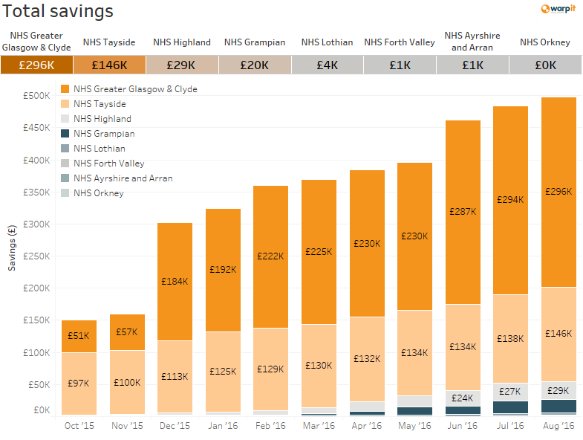
Images Only Slide
Waste & Resource Efficiency Projects
Shadow effect to be used: “Drop Shadow Rectangle”
N.B.
When scaling images/objects, please hold Shift key while scaling, to keep proportional shapes)
Notes:
Finally, the ultimate in resource reuse. In 2014, NHS National Services Scotland set up a national contract with Warp-It. Warp-It acts like a public sector ‘freecycle’ – The system allows Boards to share resources (primarily furniture) and obtain and pass-on unwanted items with other public sector partners.
The system is in its 2nd year of operation and to date 8 NHS Boards have signed up. In the last 6 months these Boards has avoided over 5 tonnes of waste, saved 107 tonnes of CO2 and supported the re-use of hundreds of items of furniture (not to mention cost savings of c £500k).

Slide 15
Quote Page
Style
A health opportunity.....
Tackling climate change could be the greatest global health opportunity of the 21st century.”
Lancet Commission on Health Effects and Climate Change, 2015

Slide 16
Thank you.
Q&A.
k.dapre@nhs.net
Kathryn Dapré
Head of Engineering, Energy & Sustainability

